Slide 1

Lab 3: From MySQL to HDFS

Slide 2
Installation
MySQL
Sqoop

Slide 3
Installation (MySQL)
sudo apt-get install mysql-server
When installing, you will be prompted to key in root password
systemctl start mysql

Slide 4
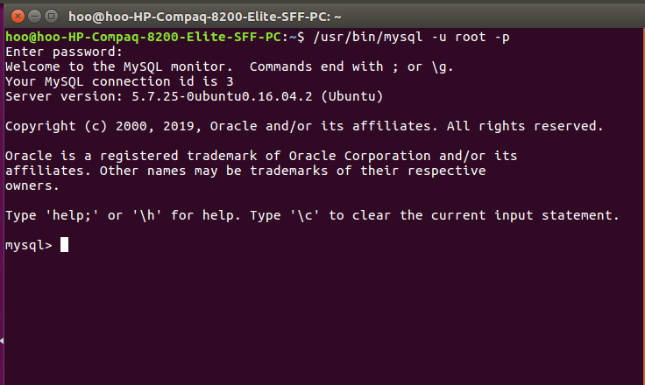
Installation (MySQL)
/usr/bin/mysql -u root -p
When you’re prompted for a password, enter the one that you set at installation time

Slide 5
MySQL: importing csv to MySQL
In MySQL:
CREATE DATABASE WQD7007;
Use WQD7007;
create table churn (customerID varchar(20), PaperlessBilling varchar(3), PaymentMethod varchar(30), MonthlyCharges numeric(8,2), Churn varchar(3));
exit
Download ‘churn_reduced.csv’ to Downloads folder, then
mysql -uroot -proot --local_infile=1 mysql -e "LOAD DATA LOCAL INFILE '~/Downloads/churn_reduced.csv' INTO TABLE churn FIELDS TERMINATED BY ','"

Slide 6
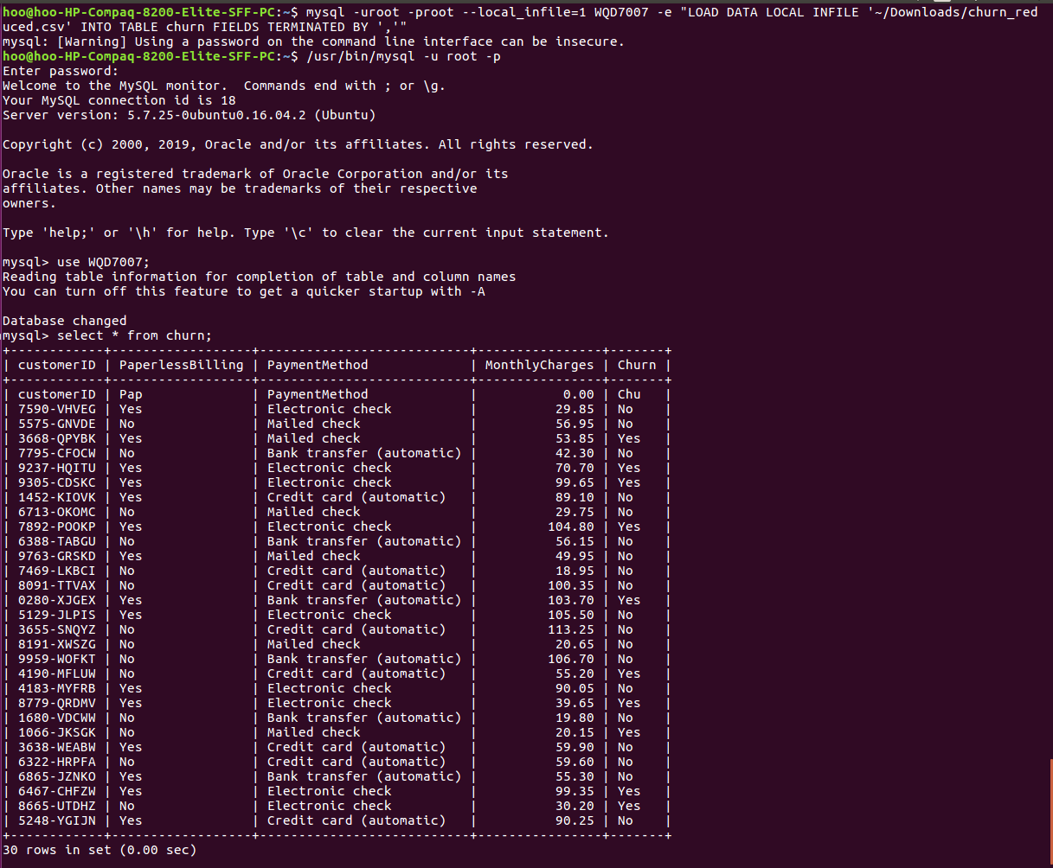
MySQL: importing csv to MySQL
Log in again, then
Use WQD7007;
Select * from churn;

Slide 7
Installation (Sqoop)
Download sqoop:
wget https://www-eu.apache.org/dist/sqoop/1.4.7/sqoop-1.4.7.bin__hadoop-2.6.0.tar.gz
Extract:
tar -xzf sqoop-1.4.7.bin__hadoop-2.6.0.tar.gz
Move sqoop to new directory:
mv sqoop-1.4.7.bin__hadoop-2.6.0 /home/wlhoo/sqoop/
At the end of .bashrc, add:
export PATH=$PATH:/home/wlhoo/sqoop/bin
source .bashrc

Slide 8
Installation (Sqoop)
mv /home/{yourname}/sqoop/conf/sqoop-env-template.sh /home/{yourname}/sqoop/conf/sqoop-env.sh
In sqoop-env.sh:
export HADOOP_COMMON_HOME=/home/{yourname}/hadoop
export HADOOP_MAPRED_HOME=/usr/{yourname}/hadoop
sqoop import -connect jdbc:mysql://localhost/WQD7007 -username root -password root -table churn -m 1

Slide 9
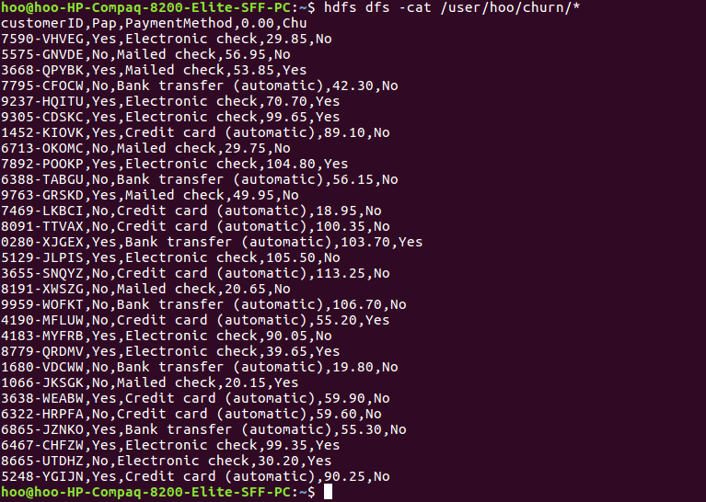
Outcome
hdfs dfs -cat /user/{your user account}/churn/*

